Slide 1
Contact Monthly Claim Systems.

Slide 2
AGENDA
Introduction
Project Overview
System Architecture
Key Features
User Roles (Lecturer, Admin, HR)
System Workflow
Database Design
Demonstration / Screenshots
Challenges & Solutions
Conclusion & Future Enhancements

Slide 3

Introduction
This project presents a Claim Management System designed to streamline how lecturers submit claims and how administrators and HR personnel review, approve, or decline them. The system replaces manual paper-based processes with a modern, digital, and efficient platform, ensuring accuracy, transparency, and faster turnaround times. Built using ASP.NET MVC, the system incorporates secure authentication, structured workflows, and real-time notifications to improve communication across all user roles.

Slide 4

PROJECT OVERVIEW
This system streamlines the claim submission and approval process by providing a digital platform where lecturers submit claims and Admin/HR review and process them. It improves speed, accuracy, and transparency.

Slide 5
SYSTEM ARCHITECTURE
SYSTEM ARCHITECTURE (Slide 3)
Key Components:
Frontend: ASP.NET Razor Pages for interactive user interface.
Backend: ASP.NET Core MVC for processing business logic.
Database: SQL Server for storing claims, users, and notifications.
Services: ClaimService handles claim verification, approval, and status updates.
Workflow Engine: Validates and automates claim approval using FluentValidation.
Notifications: Real-time notifications for Lecturers, Admin, and HR.
Security: Role-based access control for Lecturer, Admin, and HR.
Integration: Forms and file uploads for supporting documents

Slide 6
KEY FEATURES

Slide 7
Claim Submission:
Lecturers can submit claims with hours worked and supporting documents.
Automatic calculation of total claim amount.
2. Claim Management:
Admin can view, approve, or decline claims.
HR can review pending claims and finalize approval/decline.
3. Notifications:
Real-time notifications for new claims, approvals, and warnings.
4. Role-Based Access:
Separate dashboards and functionalities for Lecturer, Admin, and HR.
5. Reporting:
Track pending, approved, and declined claims.
View recent claims history.
6. Security:
Role-based access control ensures data privacy.
Data validation prevents incorrect submissions

Slide 8
USER ROLES
1. Lecturer
Submit claims with hours worked, hourly rate, and supporting documents.
View status of submitted claims (Pending, Approved, Declined).
Receive notifications on claim updates.
2. Admin
Access all lecturer claims.
Approve or decline claims based on validation rules.
Send notifications to lecturers and HR.
Monitor system activity and generate reports.
3. HR (Human Resources)
Review claims approved by Admin.
Finalize approval or decline for payment.
Receive notifications for new claims and warnings.
Maintain record of all processed claims.

Slide 9
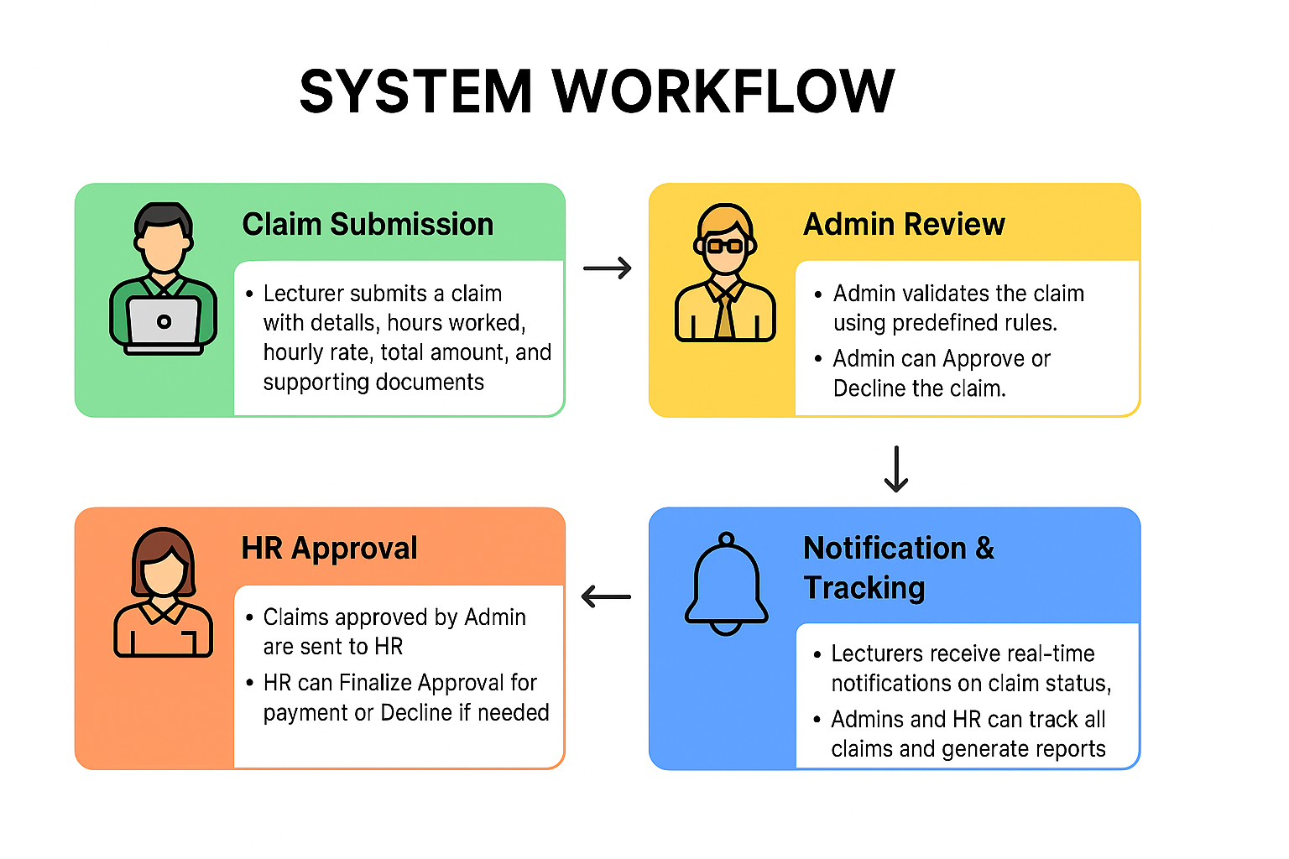
SYSTEM WORKFLOW

Slide 10
CON.
1. Claim Submission
Lecturer submits a claim with details: hours worked, hourly rate, total amount,and supporting documents.
Claim status is set to Pending.
2. Admin Review
Admin validates the claim using predefined rules.
Admin can Approve or Decline the claim.
Notifications are sent to the lecturer regarding the decision.
3. HR Approval
Claims approved by Admin are sent to HR.
HR can Finalize Approval for payment or Decline if needed.
Notifications are sent to the lecturer and Admin.
4. Notification & Tracking
Lecturers receive real-time notifications on claim status.

Slide 11
Database Design
1. Users
- UserID (Primary Key)
- Email
- Password
- Role (Admin, HR, Lecturer)
2. Claims
- ClaimID (Primary Key)
- FacallyName
- ModuleName
- Hourworked
- Hourlyrate
- TotalAmount
- SupportingDocuments
- claim_status (Pending, Approved, Declined)
- creating_date
- UserID (Foreign Key referencing Users table)
3. Notifications
- NotificationID (Primary Key)
- Type (NewClaim, Approved, Declined)
- Message
- CreatedDate
- UserID (Foreign Key referencing Users table

Slide 12
Database Design CON.
Relationships
- A user can have multiple claims (one-to-many).
- A claim is associated with one user (many-to-one).
- A user can have multiple notifications (one-to-many).
- A notification is associated with one user (many-to-one).

Slide 13
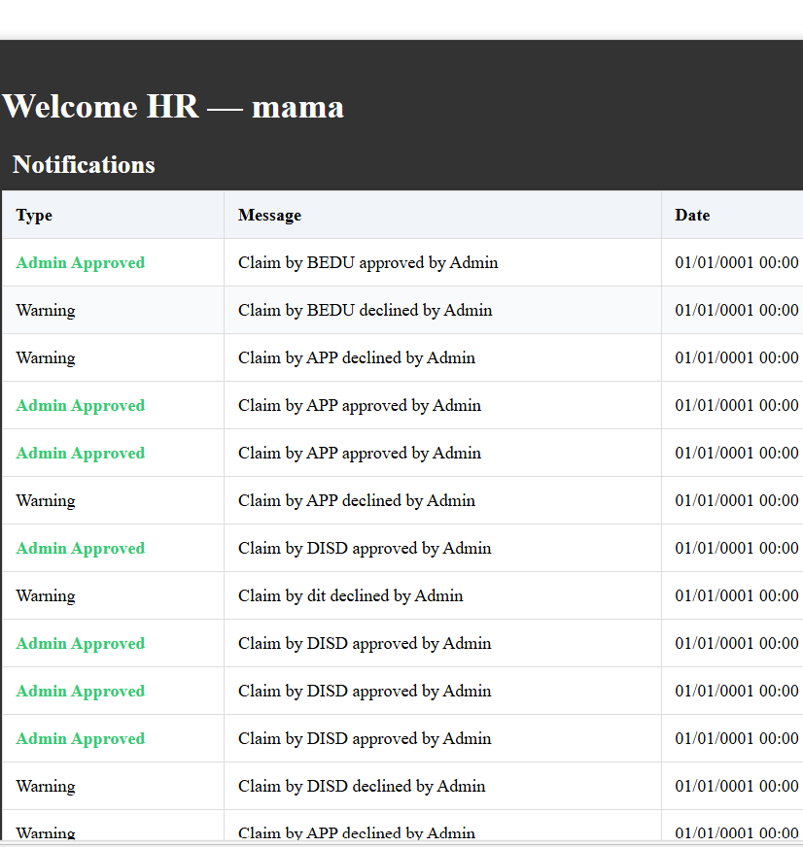
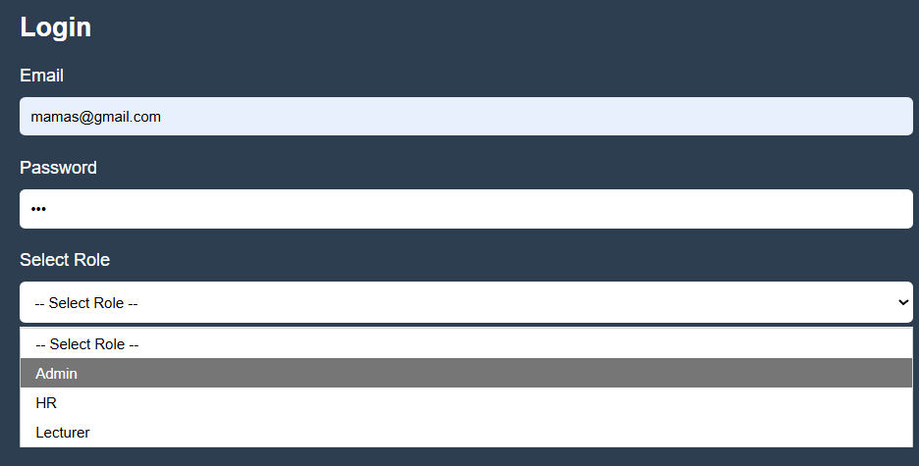
Screenshots FOR HR

Slide 14
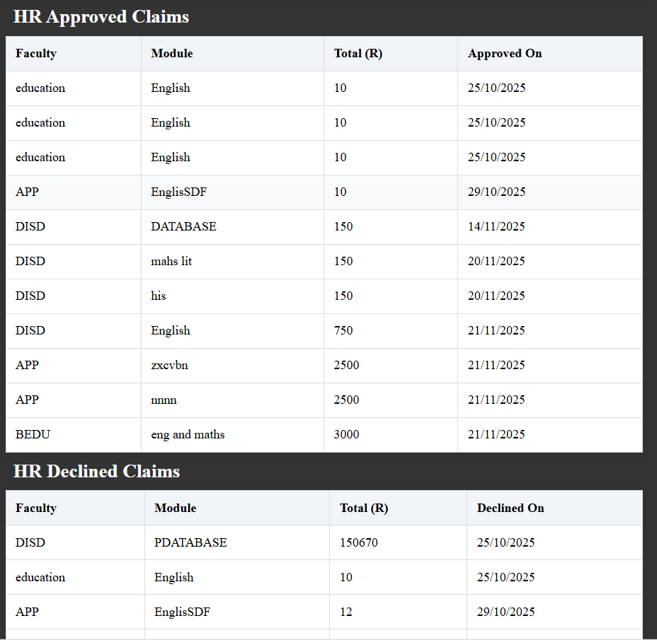
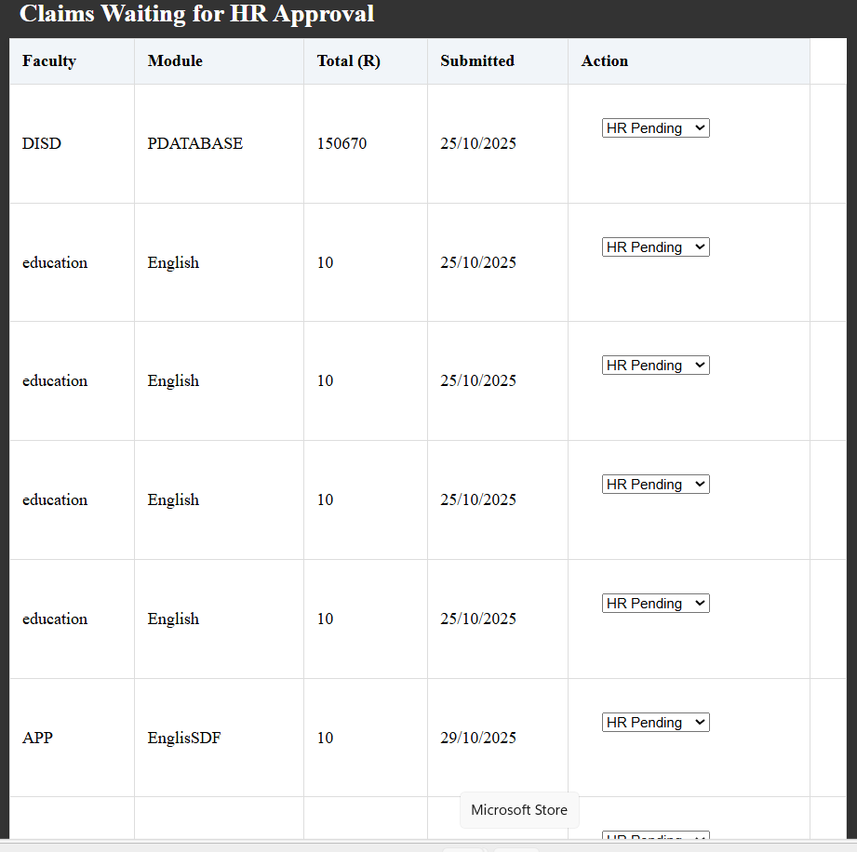
Screenshots

Slide 15
Thank you

